Slide 1
Neha Goud Baddam
DeepViral: prediction of novel virus-host interactions from protein sequences and infectious disease phenotypes
Wang Liu-Wei1 , S¸enay Kafkas1,2, Jun Chen1 , Nicholas J. Dimonaco 3 , Jesper Tegne´ r1,4 and Robert Hoehndorf 1,2,*
Oxford Academics

Slide 2
Introduction
Infectious Diseases and Pathogens
Infectious diseases arise from microorganisms (like viruses, bacteria, fungi, or parasites) called pathogens that invade and disrupt the normal functioning of a host's body.
Pathogen-Host Interactions (PHI):
Pathogen-host interactions (PHI) refer to how pathogens (like viruses) interact with the host's cells and molecular components (e.g., proteins, RNA, DNA) affecting the host’s immune system.

Slide 3
Introduction
Motivation
Infectious diseases caused by novel viruses are a growing public health concern.
Importance
Understanding Pathogen-host interactions can provide insights into the mechanisms of infectious diseases and guide therapeutic discoveries.
Existing Methods
Most methods use protein sequence features to predict virus-host interactions (PHIs).
Studying all possible PHIs can be time-consuming and expensive, computational methods are used to predict which human proteins might interact with a pathogen.
This is especially useful for new or reemerging pathogens, where experimental data may be limited.
Use known interactions as negative samples based on dissimilarity.

Slide 4
Introduction
DeepViral Approach
DeepViral Proposal: Combines protein sequence features and infectious disease phenotypes (signs and symptoms).
Goal: predict potential interactions between viruses and all human proteins.
Clinical signs and symptoms may explain molecular interactions between pathogen and host proteins. (supported by studies in Mendelian diseases).

Slide 5
Dataset
Host Pathogen Interaction Database (HPIDB)
This database contains information on how pathogens (like viruses) interact with their hosts (e.g., humans).
PathoPhenoDB
A database that connects pathogens and infectious diseases to phenotypes (i.e., observable symptoms or traits).
Human Phenotype Ontology (HPO)
HPO provides a standardized vocabulary for describing human phenotypic abnormalities (traits or symptoms that can be observed in patients).
Mouse Genome Informatics (MGI)
MGI provides phenotypic data from mouse genes, and these can be used to draw parallels with human genes.

Slide 6
Dataset
Gene Ontology (GO) Annotations
GO provides standardized terms for describing the roles of proteins in cells, including their biological processes, molecular functions, and cellular components.
String
String is a database that contains known and predicted PPIs. Only interactions with experimental evidence are used in this study.
Swiss-Prot Database
This is a high-quality database of protein sequences. The human protein sequences and viral protein sequences (e.g., from Coronaviruses) in the study are sourced from here.
PhenomeNET Ontology
This cross-species ontology contains data on phenotypes from multiple species, making it easier to compare phenotypes across species.

Slide 7
Dataset
SARS-CoV-2 and Other Coronavirus Data
These datasets include experimentally validated PHIs involving SARS-CoV-2 proteins and human proteins. The interaction data includes:
332 protein interactions involving 27 different SARS-CoV-2 proteins.
Coronaviridae (the family of viruses that includes SARS-CoV-2) interactions with human proteins are also included, giving the model more training data for making predictions

Slide 8
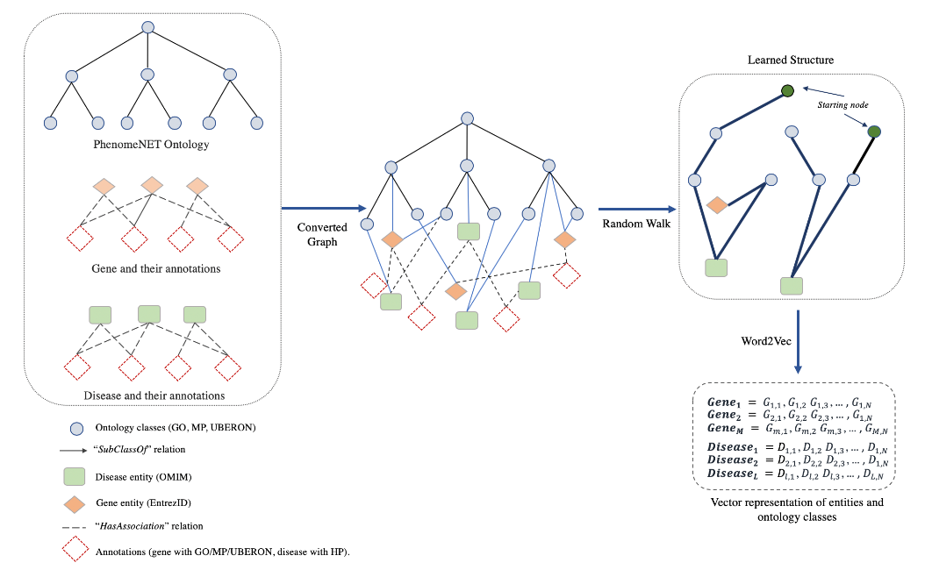
Feature Embeddings
DL2Vec method used to generate feature embeddings:

Slide 9
Feature Embeddings
Graph Construction
The first step is to convert the ontology and the associations between entities (like human proteins and viruses) into a graph, nodes represent entities (e.g., proteins, viruses) and edges represent relationships or associations (e.g., "this virus is associated with this phenotype" or "this protein belongs to this ontology class").
Random Walks
DL2Vec performs random walks over the graph. These random walks explore the neighborhood of each entity (e.g., a virus) to understand its connections to other entities (e.g., related phenotypes, taxonomic relatives). This creates a series of "paths" that reflect how these entities are connected.
Generating "Sentences"
The random walks generate a set of paths that can be thought of as sentences. Each sentence captures the relationships between entities within a local neighborhood of the graph.
Example: A sentence could be something like "virus A – associated with phenotype B – related to virus C."

Slide 10
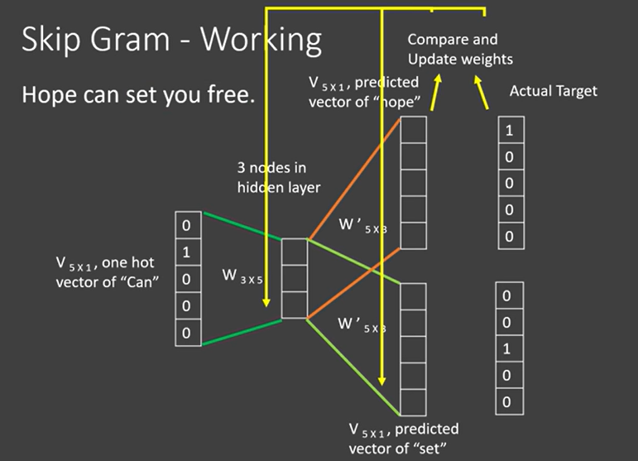
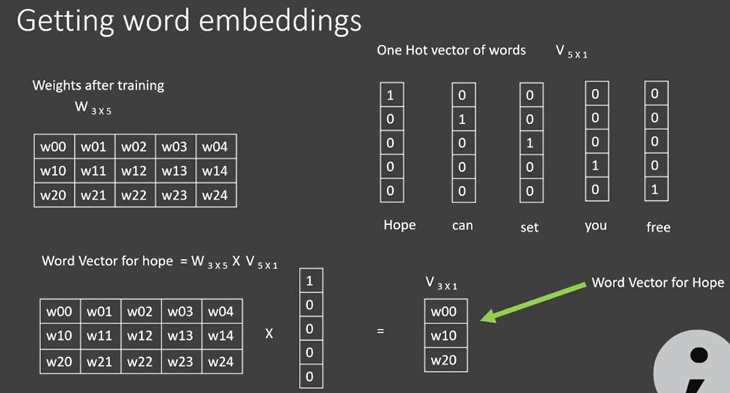
Feature Embeddings
Word2Vec Skip-gram Model
After creating these "sentences," DL2Vec uses the Word2Vec skipgram model to learn an embedding (a vector representation) for each entity.

Slide 11
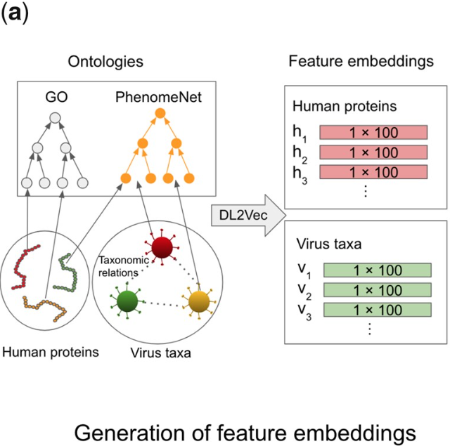
Feature Embeddings
Technical Details
Number of Walks: 100 random walks were performed starting from each entity (protein or virus).
Walk Length: Each walk was 30 steps long.
Embedding Dimension: Each entity (virus, protein) was embedded into a vector of size 100 (meaning the feature embedding is a 100-dimensional numerical vector).
Training Epochs: The Word2Vec model was trained for 30 epochs, meaning the model went through the dataset 30 times during training.

Slide 12
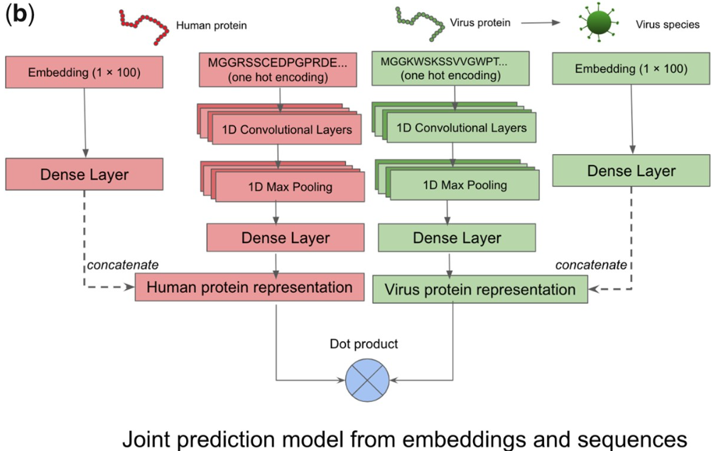
DeepViral Model
Neural network has two components:
Phenotype
Model
Based on virus and human protein feature embeddings.
A fully connected layer takes in the phenotype embeddings of the virus and human protein.
Sequence
Model
Uses amino acid sequences of proteins.
Protein sequences are one-hot encoded and processed with 1D CNN, max pooling, and fully connected layers.
A dot product was performed over the two vector representations of the pair of proteins to compute their similarity, which was then used as input to a sigmoid activation function to compute their predicted probability of interaction.

Slide 13

Supervised Prediction
Task: Predict protein-protein interactions using binary classification.
Hyperparameters: Filter sizes, pool sizes, and number of neurons tuned via grid search.
Dropout is used to prevent overfitting, with Leaky ReLU as activation function.
Loss function: Binary cross-entropy.

Slide 14
Results
Embedding features of viruses and human proteins from phenotypes, functions, and taxonomies
Virus Phenotype Embeddings
This approach generated a generalized representation (or embedding) for viruses based on the symptoms they cause or those caused by their taxonomic relatives.
Virus phenotypes from PathoPhenoDB.
Expanded with taxonomic relations from NCBI Taxonomy to cover viruses without phenotype annotations.
Human Protein Embeddings
Human phenotypes from HPO.
Mouse ortholog phenotypes from MGI.
Protein functions from Gene Ontology (GO).
Propagation Through PPI Network: These phenotype and function annotations were further propagated through the human protein-protein interaction (PPI) network
Cross-Species Ontologies for Enhanced Representation
Used cross-species phenotype ontology PhenomeNET (includes GO).
Formalized biological knowledge improves machine learning performance by enhancing feature representations.

Slide 15
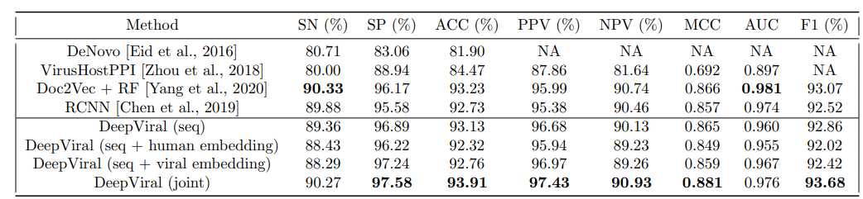
Results
Joint Model for PPI Prediction from Sequences and Phenotypes
Comparison with Existing Method RCNN on existing data (Eid et al., 2016)
When trained solely on protein sequences, the model performed comparably to other sequence-based methods.
When using the joint model (combining phenotype and sequence information), outperformed other methods across most evaluation metrics.

Slide 16
Results
Experimental Setup, Negative Sampling, and Evaluation Metrics for Novel Viruses
Leave-One-Family-Out (LOFO) Cross Validation:
Evaluation Objective:
To simulate the scenario of predicting PPIs for a novel virus.
Negative Sampling
Avoids dissimilarity-based negatives; instead, assumes all unknown pairs are negatives.
Evaluation Metrics
ROCAUC: Area under the receiver operating characteristic curve.
Mean ranks of true positives: Lower ranks indicate better performance, as the true interaction partners are ranked higher among all possible candidates.
Results
Each evaluation was repeated five times to compute a 95% confidence interval, calculated as mean ± 1.96 × (σn), where σ is the standard deviation and n is the sample size.
Dataset: To address the limitations of existing datasets and predict novel protein-protein interactions (PPIs) for previously unknown viruses.
Positive Set: 24,678 interactions, 1,066 viral proteins from 14 virus families.
Filtered from HPIDB based on criteria like confidence scores (MIscore) and taxonomy (NCBI).

Slide 17
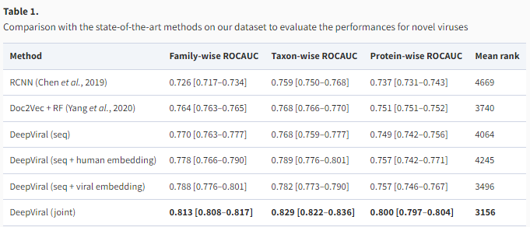
Results
Phenotypes Improve Prediction for Novel Viruses
Evaluating novel viruses with no prior knowledge, except for protein sequences and host phenotypes.
DeepViral and Doc2Vec + RF perform comparably.
RCNN shows the lowest performance across metrics.

Slide 18
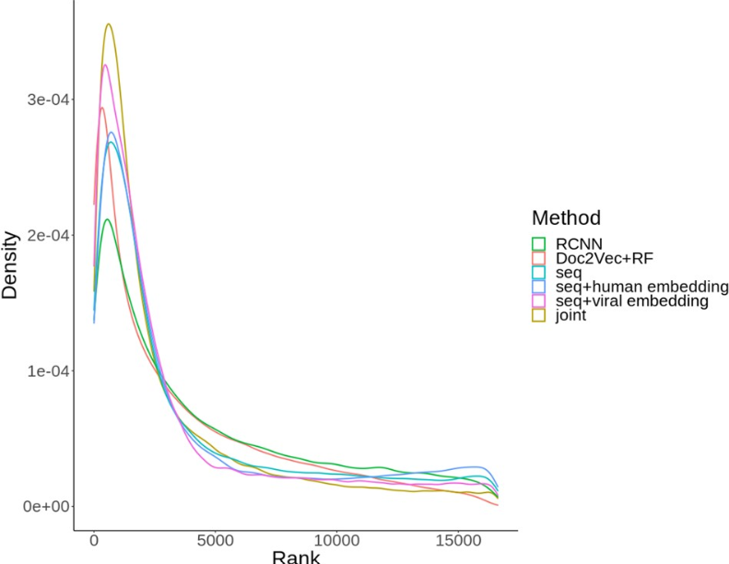
Results
Embeddings Impact:
Mean rank is calculated by taking the rank position of a true positive interaction within the full list of all potential human protein interaction partners for a specific virus.
Adding human or virus embeddings separately provides slight improvements.
The joint model (embeddings + sequences) achieves the best overall performance.

Slide 19
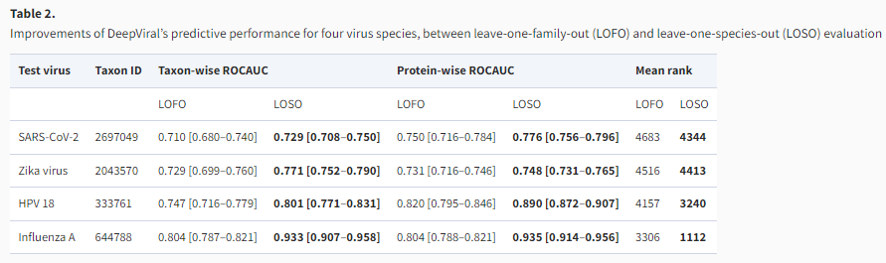
Discussions
Species-Level Optimization for Novel Viruses
LOFO vs. LOSO:
LOFO: Leaves out the entire family of the virus, simulating a novel virus scenario.
LOSO: Includes data from taxonomic relatives to improve performance.
Results: LOSO improves performance, showing the benefit of including viral family data in predicting protein interactions.

Slide 20
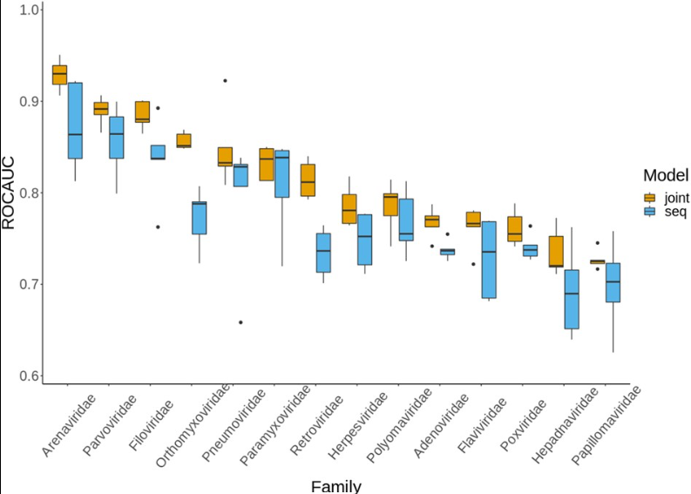
Discussions
Species-Level Optimization for Novel Viruses (LOFO experiments)
Case Study: SARS-CoV-2
DeepViral predicted an interaction between the M protein and TBK1 (innate immune response).
Prediction was validated in follow-up studies, demonstrating DeepViral's ability to discover biologically relevant interactions.

Slide 21
Discussions
2. Using Phenotypes to Reveal Molecular Mechanisms of Viral Infections
Phenotypes used in DeepViral offer a significant advantage.
Phenotypes act as a proxy for underlying infection mechanisms.
Challenge
One of the challenges in using phenotypes to predict PHIs is the contextual differences in how they are derived.
Phenotypic features observed in humans and mice
Using phenotypic features from humans and mice, DeepViral identifies the RNA helicase DDX3X as a potential interaction partner of the Zika virus protein

Slide 22
LIMITATION & FUTURE WORK
Scarcity of training data for inter-species protein-protein interactions (PPIs).
Could improve with transfer learning on intra-species data.
Expand scope beyond virus-human PHIs to include:
Other pathogens (bacteria, fungi).
Zoonotic diseases (PHIs in animals).
Future insights
Predict tissue-specific PHIs to better understand viral and human protein interactions.

Slide 23

Questions?

Slide 24
Thank You!

